Slide 1
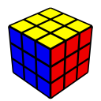
Solving the Cube – Pt. 4
Michael George
WCA ID: 2015GEOR02

Slide 2
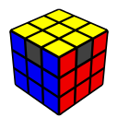
Permutation of the Last Layer (PLL)
Approach
Permutation of the Last Layer (PLL) will be broken into in 2 sub-steps
Corner Permutation of the Last Layer (CPLL)
Edge Permutation of the Last Layer (EPLL)
Manipulation of the F2L can be used to change the permutation of the last layer
e.g. Extracting an F2L pair (or two) then re-inserting the pair(s) using a different “triggers”
This approach requires two “algorithms” which are essentially combinations of simple “algorithms”
Algorithm for corner permutation (CPLL) – Combination of 2 simple algorithms using R U L moves
Algorithm for edge permutation (EPLL) – Combination of 2 simple algorithms using R U L moves

Slide 3
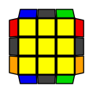
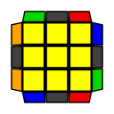
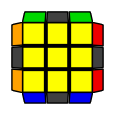
Corner Permutation of the Last Layer (CPLL)
There are 3 possible cases during CPLL including the “solved” case
Cases: The cases that need to be solved are the “diagonal corner swap” and the “adjacent corner swap”
Probabilities: The “adjacent” corner swap is the most common CPLL as it occurs in 4/6 solves
Approach: A combination of 2 simple algorithms can be used to cycle through the CPLL cases
1/6
4/6
1/6

Slide 4
CPLL Algorithm
To change the permutation of corners you will use a mixture of R U L moves
The CPLL algorithm that will be used is (R U2 R’ U2’) (U R U’ R’) (R U’ L’ U) (R’ U’ L U)
It may look daunting but it is actually two shorter algorithms
It starts with the Anti-Sune algorithm that was used for OCLL – (R U2 R’ U2’) (U R U’ R’)
It ends with the Niklas algorithm which manipulates two F2L pairs – (R U’ L’ U) (R’ U’ L U)
The combination of these two algorithms is the Jb-Perm which swaps 2 LL corners and 2 LL edges
Explanation of the algorithm(s)
The Anti-Sune algorithm disorients 3 of the LL corners and permutes 3 of the LL edges
The Niklas algorithm re-orients the LL corners and changes their permutation
The combined effect of these two algorithms is to maintain the OLL but change the PLL
Setup for the algorithm
The key to using this algorithm is knowing the appropriate “setup” prior to execution

Slide 5
Adjacent Corner Swap
The “adjacent” corner swap can be recognised by the “headlights” on one side (shown in orange below)
Approach: “Adjacent corner swap” -> “solved”
Setup: Ensure the “Headlights” are on the left before executing the CPLL algorithm
Algorithm: (R U2 R’ U2’) (U R U’ R’) (R U’ L’ U) (R’ U’ L U)
Adjacent Swap
Solved

Slide 6
Diagonal Corner Swap
The “diagonal” corner swap can be recognised by the absence of “headlights”
Approach: “Diagonal corner swap” -> “adjacent corner swap” -> “solved”
Setup: Ensure the “Headlights” are on the left before executing the ”adjacent corner swap”
Algorithm: (R U2 R’ U2’) (U R U’ R’) (R U’ L’ U) (R’ U’ L U) – twice, remembering to AUF prior to execution
Diagonal Swap
Adjacent Swap
Solved

Slide 7
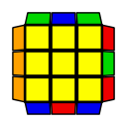
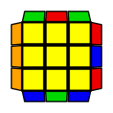
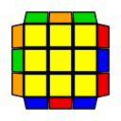
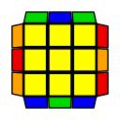
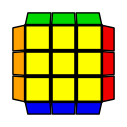
Edge Permutation of the Last Layer (EPLL)
There are 5 possible cases during EPLL including the “solved” case
4/12
4/12
2/12
1/12
1/12

Slide 8
Edge Permutation of the Last Layer (EPLL)
EPLL can be solved by cycling through the cases in a similar fashion to CPLL
Cases: There can only be 3 or 4 misplaced edges, corresponding to the images on the previous slide
Probabilities: The most common cases are the “3-cycles” as they occur in 8/12 solves
Approach: Cycle from 4 misplaced edges -> 3 misplaced edges -> “solved”
e.g.
Z-Perm
Ub-Perm
Solved

Slide 9
EPLL Algorithm
To change the permutation of edges you can use a mixture of R U L moves
The EPLL algorithm that will be used is (R U2 R’ U2’) (U R U’ R’) U (L’ U2 L U2’) (U’ L’ U L)
It may look daunting but it is actually two Anti-Sune algorithms
It starts with the Anti-Sune algorithm that was used for OCLL – (R U2 R’ U2’) (U R U’ R’)
It ends with the left-handed “mirror” – (L’ U2 L U2’) (U’ L’ U L)
The combination of these two algorithms is the Ub-Perm which is a clockwise “3-cycle” of LL edges
Explanation of the algorithm(s)
The first Anti-Sune algorithm disorients 3 of the LL corners and permutes 3 of the LL edges
The second Anti-Sune algorithm re-orients all of the LL corners and permutes 3 of the LL edges
The combined effect of the two algorithms is to maintain the OLL but change the EPLL

Slide 10
3 Misplaced Edges
There are 2 EPLL cases with 3 misplaced edges and they can be recognised by the “bar” (orange below)
Approach: “Ua-Perm” -> “Ub-Perm” -> “Solved”
Setup: Ensure the ”Bar” is on the left before executing the EPLL algorithm
Algorithm: (R U2 R’ U2’) (U R U’ R’) U (L’ U2 L U2’) (U’ L’ U L) – once or twice, remembering to AUF
Ua-Perm
Ub-Perm
Solved

Slide 11
4 Misplaced Edges
There are 2 EPLL cases with 4 misplaced edges and they take the most effort to solve
Approach: “Z-Perm” or “H-Perm” -> “Ub-Perm” -> “Solved”
Setup: Avoid the “Ua-Perm” by setting up the Z-Perm correctly before executing the EPLL algorithm
Algorithm: (R U2 R’ U2’) (U R U’ R’) U (L’ U2 L U2’) (U’ L’ U L) – twice, remembering to AUF
or
H-Perm
Z-Perm
Ub-Perm
Solved

Slide 12
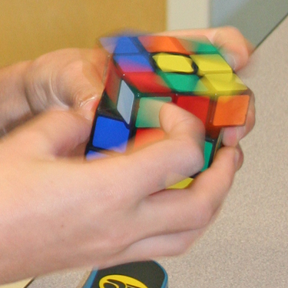
Finger Tricks
(R U2 R’ U2’) (U R U’ R’)
Use your index finger(s) to turn the U-layer for the “setup” instead of rotating the cube around the y-axis
Re-grip so that your right thumb is underneath the R-face and fingers are on top before executing the algorithm
Execute the whole algorithm without re-gripping
The U2 can be executed as a “double flick” – i.e. index finger followed by middle finger
(L’ U2 L U2’) (U’ L’ U L)
Use your index finger(s) to turn the U-layer for the “setup”
Execute the whole algorithm without re-gripping
The U2 can be executed as a “double flick” – i.e. index finger followed by middle finger

Slide 13
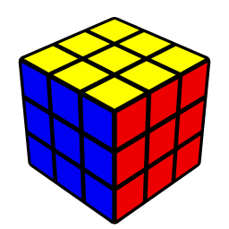

Congratulations!

